Slide 1
DATA LINK LAYER(DLL)
HARISH KUMAR H C
Asst.Professor

Slide 2
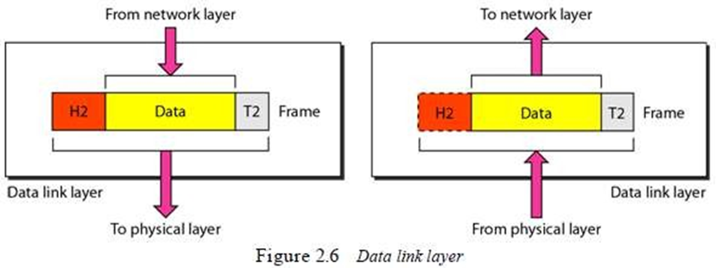
Data Link Layer
Main Responsibility:
Data-link-layer (DLL) is responsible for moving frames from one node to another node.

Slide 3
Data Link Layer
Other responsibilities of data-link-layer
1)Framing
DLL receives & divides the stream of bits from network-layer into frames.
2)Physical-addressing
DLL appends a header to the frame coming from the network-layer.
Header contains the physical-address of sender & receiver of the frame.
3)Flow Control
DLL provides flow-control.
Flow-control ensures that source sends the data at a speed at which destination can receive it
If there is an overflow at the receiver-side, the data will be lost.

Slide 4
Data Link Layer
4)Error Control
DLL provides error-control.
Error-control is process of identification or correction of error occurred in the transmitted data
Error-control uses mechanisms to
→ detect damaged-frames
→ retransmit lost-frames
→ recognize duplicate frames.
Normally, error control information is present in the trailer of a frame.
5)Access Control
DLL provides access-control.
Access-control determines which device has right to send the data in a multipoint connection.

Slide 5
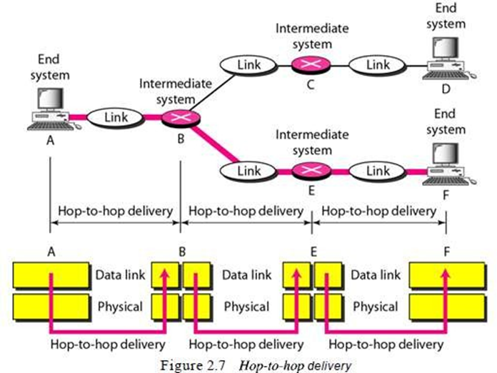
Data Link Layer

Slide 6
ERROR-DETECTION AND CORRECTION
BY
HARISH KUMAR H C

Slide 7
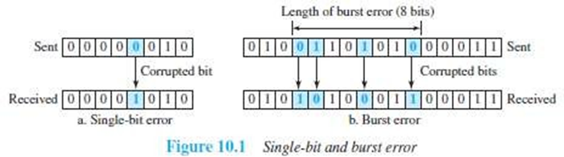
Types of Errors
When bits flow from one point to another, they are subject to unpredictable-changes because of interference.
The interference can change the shape of the signal.
Two types of errors:
Single-bit error
Burst-error.

Slide 8
Types of Errors
1) Single-Bit Error
Only 1 bit of a given data is changed
from 1 to 0 or
from 0 to 1 (Figure 10.1a).
2) Burst Error
Two or more bits in the data have changed
from 1 to 0 or
from 0 to 1 (Figure 10.1b).
A burst-error occurs more than a single-bit error. This is because: Normally, the duration of noise is longer than the duration of 1-bit.
When noise affects data, the noise also affects the bits.
The no. of corrupted-bits depends on
data-rate and
duration of noise.

Slide 9
Redundancy
The central concept in detecting/correcting errors is redundancy.
Some extra-bits along with the data have to be sent to detect/correct errors. These extra bits are called redundant-bits.
The redundant-bits are
added by the sender and
removed by the receiver.
The presence of redundant-bits allows the receiver to detect/correct errors.

Slide 10
Error Detection vs. Error Correction
Error-correction is more difficult than error-detection.
1) Error Detection
Here, we are checking whether any error has occurred or not.
The answer is a simple YES or NO.
We are not interested in the number of corrupted-bits.
2) Error Correction
Here, we need to know
exact number of corrupted-bits and
location of bits in the message.
Two important factors to be considered:
Number of errors and
Message-size.

Slide 11
Coding
Redundancy is achieved through various coding-schemes.
Sender adds redundant-bits to the data-bits. This process creates a relationship between redundant-bits and data-bits.
Receiver checks the relationship between redundant-bits & data-bits to detect/correct errors.
Two important factors to be considered:
Ratio of redundant-bits to the data-bits
Robustness of the process.
Two broad categories of coding schemes:
Block-coding.
Convolution coding.

Slide 12
Block Coding
The message is divided into k-bit blocks. These blocks are called data-words.
Here, r-redundant-bits are added to each block to make the length n=k+r.
The resulting n-bit blocks are called code-words.
Since n>k, the number of possible code-words is larger than the number of possible data-words.
Block-coding process is 1-to-1; the same data-word is always encoded as the same code-word.
Thus, we have 2^{n}-2^{k} code-words that are not used. These code-words are invalid or illegal.

Slide 13
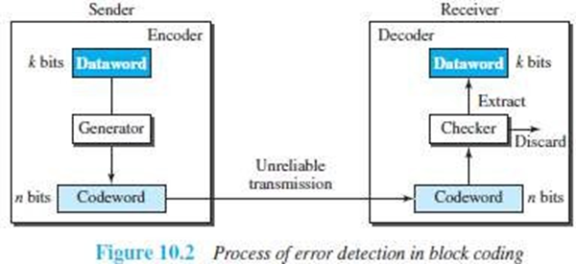
Error Detection
If the following 2 conditions are met, the receiver can detect a change in the original code-word:
The receiver has a list of valid code-words.
The original code-word has changed to an invalid code-words.

Slide 14
How it works?
At Sender
The sender creates code-words out of data-words by using a generator.
The generator applies the rules and procedures of encoding.
During transmission, each code-word sent to the receiver may change.
At Receiver
If the received code-word is the same as one of the valid code-words, the code-word is accepted; the corresponding data-word is extracted for use.
If the received code-word is invalid, the code-word is discarded.
However, if the code-word is corrupted but the received code-word still matches a valid code- word, the error remains undetected.
An error-detecting code can detect only the types of errors for which it is designed; other types of errors may remain undetected.

Slide 15
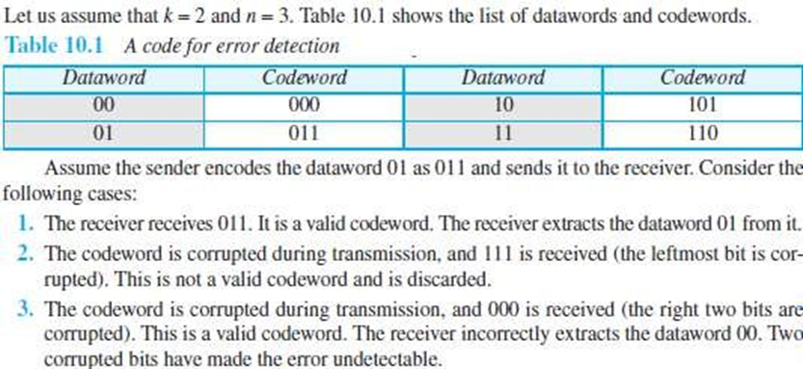
Example

Slide 16
Hamming Distance
The main concept for error-control is the idea of the Hamming distance.
The Hamming distance b/w 2 words is the number of differences between the corresponding bits.
Let d(x,y) = Hamming distance b/w 2 words x and y.
Hamming distance can be found by
applying the XOR operation on the 2 words and
counting the number of 1s in the result.

Slide 17
Hamming Distance
For example:
The Hamming distance d(000, 011) is 2 because 000⊕011= 011 (two 1s).
The Hamming distance d(10101, 11110) is 3 because 10101⊕11110 = 01011 (three 1s).
Hamming Distance and Error
Hamming distance between the received word and the sent code-word is the number of bits that are corrupted during transmission.
For example:
Let Sent code-word = 00000
Received word = 01101
Hamming distance = d(00000, 01101) =3. Thus, 3 bits are in error.

Slide 18
Minimum Hamming Distance for Error Detection
Minimum Hamming distance is the smallest Hamming distance b/w all possible pairs of code-words.
Let dmin = minimum Hamming distance.
To find dmin value, we find the Hamming distances between all words and select the smallest one.
Minimum-distance for Error-detection
If ‘s’ errors occur during transmission, the Hamming distance b/w the sent code-word and received code-word is ‘s’ (Figure 10.3).
If code has to detect upto ‘s’ errors, the minimum-distance b/w the valid codes must be ‘s+1’
i.e. d min=s+1.
We use a geometric approach to define d min=s+1.

Slide 19
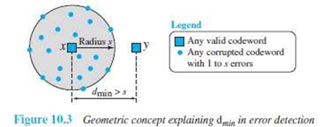
Minimum Hamming Distance for Error Detection
Let us assume that the sent code-word x is at the center of a circle with radius s.
All received code-words that are created by 0 to s errors are points inside the circle or on the perimeter of the circle.
All other valid code-words must be outside the circle
For example: A code scheme has a Hamming distance dmin = 4.
This code guarantees the detection of upto 3 errors (d = s + 1 or s = 3).

Slide 20
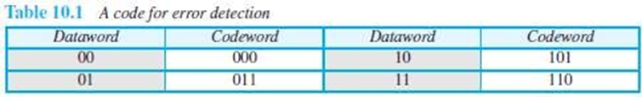
Linear Block Codes
Almost all block codes belong to a subset of block codes called linear block codes.
A linear block code is a code in which the XOR of 2 valid code-words creates another valid code-word. (XOR →Addition modulo-2)
The code in Table 10.1 is a linear block code because the result of XORing any code-word with any other code-word is a valid code-word.
For example, the XORing of the 2nd and 3rd code-words creates the 4th one.

Slide 21
Minimum Distance for Linear Block Codes
Minimum Hamming distance is no. of 1s in the nonzero valid code-word with the smallest no. of 1s.
In Table 10.1,
The numbers of 1s in the nonzero code-words are 2, 2, and 2. So the minimum Hamming distance is dmin = 2.

Slide 22
Parity Check Code
This code is a linear block code. This code can detect an odd number of errors.
A k-bit data-word is changed to an n-bit code-word where n=k+1.
One extra bit is called the parity-bit.
The parity-bit is selected to make the total number of 1s in the code-word even.
Minimum hamming distance dmin = 2. This means the code is a single-bit error-detecting code.

Slide 23
Parity Check Code

Slide 24
Parity Check Code
Here is how it works
At Sender
The encoder uses a generator that takes a copy of a 4-bit data-word (a0, a1, a2, and a3) and generates a parity-bit r0.
The encoder
accepts a copy of a 4-bit data-word (a0, a1, a2, and a3) and
generates a parity-bit r0 using a generator
generates a 5-bit code-word
The parity-bit & 4-bit data-word are added to make the number of 1s in the code-word even.
The addition is done by using the following:
The result of addition is the parity-bit.
If the no. of 1s in data-word = even, result = 0. (r0=0)
If the no. of 1s in data-word = odd, result = 1. (r0=1)
In both cases, the total number of 1s in the code-word is even.
The sender sends the code-word, which may be corrupted during transmission.

Slide 25
Parity Check Code
At Receiver
The receiver receives a 5-bit word.
The checker performs the same operation as the generator with one exception: The addition is done over all 5 bits.
The result is called the syndrome bit (s0).
Syndrome bit = 0 when the no. of 1s in the received code-word is even; otherwise, it is 1.
The syndrome is passed to the decision logic analyzer.
If s0=0, there is no error in the received code-word. The data portion of the received code-word is accepted as the data-word.
If s0=1, there is error in the received code-word. The data portion of the received code-word is discarded. The data-word is not created.

Slide 26
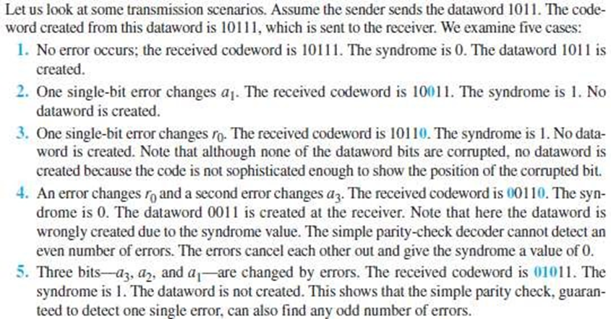
Example

Slide 27
Cyclic Codes
Cyclic codes are special linear block codes with one extra property:
If a code-word is cyclically shifted (rotated), the result is another code-word.
For ex: if code-word = 1011000 and we cyclically left-shift, then another code-word = 0110001.
Let First-word = a0 to a6 and Second-word = b0 to b6, we can shift the bits by using the following:

Slide 28
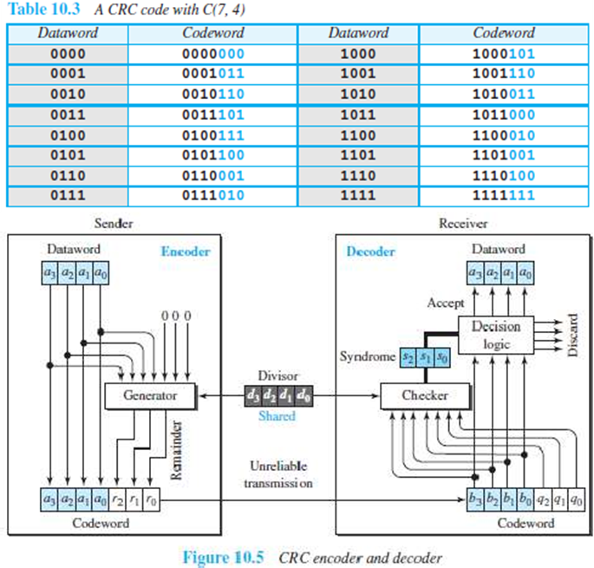
Cyclic Codes
CRC is a cyclic code that is used in networks such as LANs and WANs.

Slide 29
Cyclic Codes
Let Size of data-word = k bits (here k=4).
Size of code-word = n bits (here n=7).
Size of divisor = n-k+1 bits (here n-k+1=4).
How it works?
At Sender
n-k 0s is appended to the data-word to create augmented data-word. (here n-k=3).
The augmented data-word is fed into the generator .
The generator divides the augmented data-word by the divisor.
The remainder is called check-bits (r2r1r0).
The check-bits (r2r1r0) are appended to the data-word to create the code-word.

Slide 30
Cyclic Codes
At Receiver
The possibly corrupted code-word is fed into the checker.
The checker is a replica of the generator.
The checker divides the code-word by the divisor.
The remainder is called syndrome bits (r2r1r0).
The syndrome bits are fed to the decision-logic-analyzer.
The decision-logic-analyzer performs following functions:
i)For No Error
If all syndrome-bits are 0s, the received code-word is accepted.
Data-word is extracted from received code-word
ii)For Error
If all syndrome-bits are not 0s, the received code-word is discarded.

Slide 31
Cyclic Codes

Slide 32
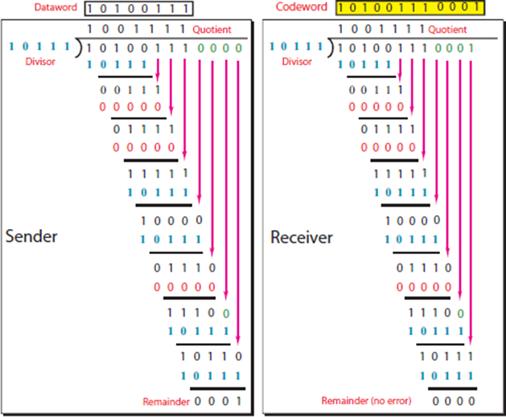
Cyclic Codes
Example

Slide 33
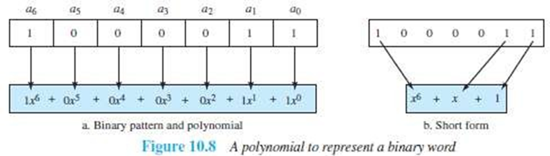
Polynomials
A pattern of 0s and 1s can be represented as a polynomial with coefficients of 0 and 1.
The power of each term shows the position of the bit; the coefficient shows the value of the bit.

Slide 34
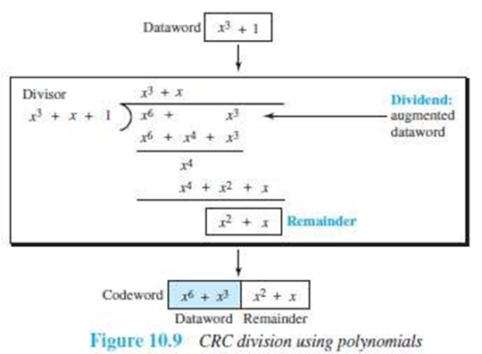
Cyclic Code Encoder Using Polynomials
Let Data-word = 1001 = x³+1.
Divisor = 1011 = x³+x+1.
In polynomial representation, the divisor is referred to as generator polynomial t(x)

Slide 35
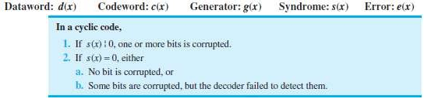
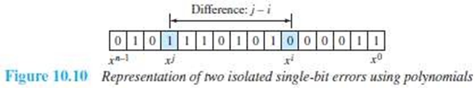
Cyclic Code Analysis
We define the following, where f(x) is a polynomial with binary coefficients:
Single Bit Error
If the generator has more than one term and the coefficient of x⁰ is 1, all single-bit errors can be caught.
Two Isolated Single-Bit Errors
If a generator cannot divide x^{i}+1 (t between 0 & n-1), then all isolated double errors can be detected

Slide 36
Checksum
Checksum is an error-detecting technique.
Used in Internet,
The checksum is mostly used at the network and transport layer.
The checksum is not used in the data link layer.
Like linear and cyclic codes, the checksum is based on the concept of redundancy.
Here is how it works :
At Source
Firstly the message is divided into m-bit units.
Then, the generator creates an extra m-bit unit called the checksum.
The checksum is sent with the message.

Slide 37
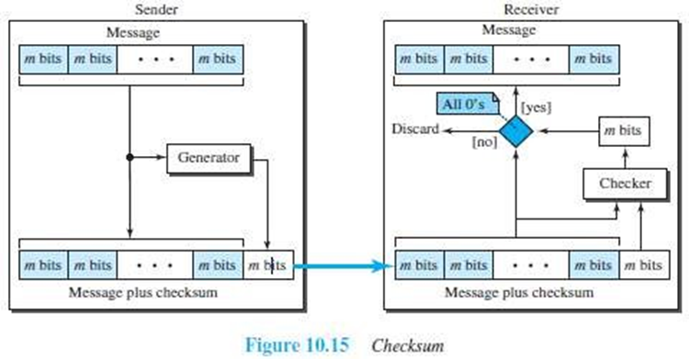
Checksum
At Destination
The checker creates a new checksum from the combination of the message and sent- checksum.
If the new checksum is all 0s, the message is accepted.
If the new checksum is not all 0s, the message is discarded.

Slide 38
Concept of Checksum
Consider the following example:
Our data is a list of five 4-bit numbers that we want to send to a destination.
In addition to sending these numbers, we send the sum of the numbers.
example1:
Let set of numbers = (7, 11, 12, 0, 6).
We send (7, 11, 12, 0, 6, 36), where 36 is the sum of the original numbers.
The receiver adds the five numbers and compares the result with the sum.
If the result & the sum are the same,
The receiver assumes no error, accepts the five numbers, and discards the sum. Otherwise, there is an error somewhere and the data are not accepted.
example2:
To make the job of the receiver easy if we send the negative (complement) of the sum, called the checksum.
In this case, we send (7, 11, 12, 0, 6, -36).
The receiver can add all the numbers received (including the checksum).
If the result is 0, it assumes no error; otherwise, there is an error.

Slide 39
One's Complement
The previous example has one major drawback.
All of our data can be written as a 4-bit word (they are less than 15) except for the checksum.
Solution: Use one's complement arithmetic.
We can represent unsigned numbers between 0 and 2^{n-1} using only n bits.
If the number has more than n bits, the extra leftmost bits need to be added to the n rightmost bits (wrapping).
A negative number can be represented by inverting all bits (changing 0 to 1 and 1 to 0).
This is the same as subtracting the number from 2^{n-1}.

Slide 40
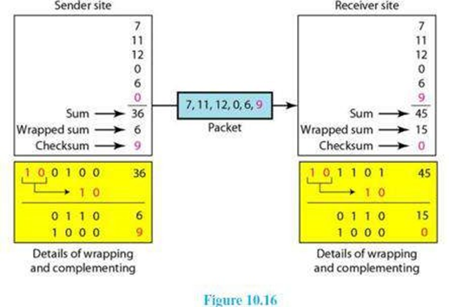
One's Complement

Slide 41
One's Complement
Here is how it works:
At Sender
The sender initializes the checksum to 0 and adds all data items and the checksum.
The result is 36.
However, 36 cannot be expressed in 4 bits.
The extra two bits are wrapped and added with the sum to create the wrapped sum value 6.
The sum is then complemented, resulting in the checksum value 9 (15 - 6 = 9).
The sender now sends six data items to the receiver including the checksum 9.

Slide 42
One's Complement
At Receiver
The receiver follows the same procedure as the sender.
It adds all data items (including the checksum); the result is 45.
The sum is wrapped and becomes 15. The wrapped sum is complemented and becomes 0.
Since the value of the checksum is 0, this means that the data is not corrupted. The receiver drops the checksum and keeps the other data items.
If the checksum is not zero, the entire packet is dropped.

Slide 43
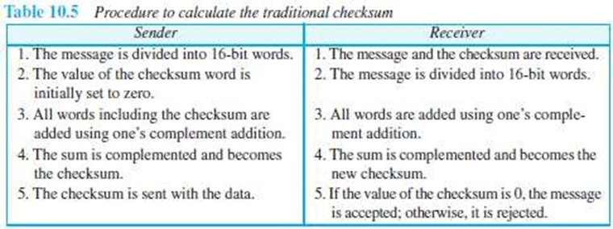
One's Complement
Internet Checksum
Traditionally, the Internet has been using a 16-bit checksum.
The sender or the receiver uses five steps.

Slide 44
DLC SERVICES
The data link control (DLC) deals with procedures for communication between two adjacent nodes i.e. node-to-node communication.
Data link control functions include
Framing
Flow control
Error control.
Framing
A frame is a group of bits.
Framing means organizing the bits into a frame that are carried by the physical layer.
The data-link-layer needs to form frames, so that each frame is distinguishable from another.
Framing separates a message from other messages by adding sender-address & destination-address.
The destination-address defines where the packet is to go.
The sender-address helps the recipient acknowledge the receipt.

Slide 45
Why the whole message is not packed in one frame?
Large frame makes flow and error-control very inefficient.
Even a single-bit error requires the re-transmission of the whole message.
When a message is divided into smaller frames, a single-bit error affects only that small frame.
Our postal system practices a type of framing. The simple act of inserting a letter into an envelope separates one piece of information from another; the envelope serves as the delimiter. In addition, each envelope defines the sender and receiver addresses since the postal system is a many-to-many carrier facility.

Slide 46
Frame Size
Two types of frames:
Fixed Size Framing
There is no need for defining boundaries of frames; the size itself can be used as a delimiter.
Example: ATM WAN uses frames of fixed size called cells.
Variable Size Framing
We need to define the end of the frame and the beginning of the next frame.
Two approaches are used:
Character-oriented approach
Bit-oriented approach

Slide 47
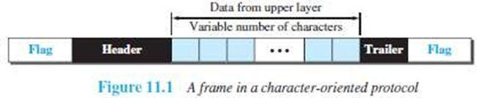
Character Oriented Framing
Data to be carried are 8-bit characters from a coding system such as ASCII.
The header and the trailer are also multiples of 8 bits.
Header carries the source and destination-addresses and other control information.
Trailer carries error-detection or error-correction redundant bits.
To separate one frame from the next frame, an 8- bit (1-byte) flag is added at the beginning and the end of a frame.
The flag is composed of protocol-dependent special characters.
The flag signals the start or end of a frame.

Slide 48
Character Oriented Framing
Problem:
Character-oriented framing is suitable when only text is exchanged by the data-link-layers.
However, if we send other type of information (say audio/video), then any pattern used for the flag can also be part of the information.
If the flag-pattern appears in the data-section, the receiver might think that it has reached the end of the frame.
Solution: A byte-stuffing is used.
(Byte stuffing →character stuffing)
In byte stuffing, a special byte is added to the data-section of the frame when there is a character with the same pattern as the flag.
The data-section is stuffed with an extra byte. This byte is called the escape character (ESC), which has a predefined bit pattern.

Slide 49
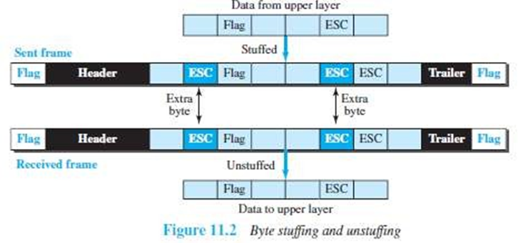
Character Oriented Framing
Problem:
What happens if the text contains one or more escape characters followed by a flag?
The receiver removes the escape character, but keeps the flag, which is incorrectly interpreted as the end of the frame.
Solution:
Escape characters part of the text must also be marked by another escape character.
In short, byte stuffing is the process of adding one extra byte whenever there is a flag or escape character in the text.

Slide 50
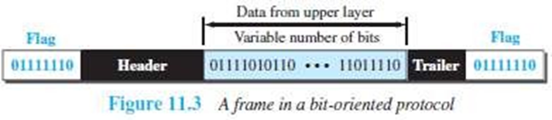
Bit Oriented Framing
The data-section of a frame is a sequence of bits to be interpreted by the upper layer as text, audio, video, and so on.
In addition to headers and trailers, we need a delimiter to separate one frame from the other.
Most protocols use a special 8-bit pattern flag 01111110 as the delimiter to define the beginning and the end of the frame

Slide 51
Bit Oriented Framing
Problem:
If the flag-pattern appears in the data-section, the receiver might think that it has reached the end of the frame.
Solution: A bit-stuffing is used.
In bit stuffing, if a 0 and five consecutive 1 bits are encountered, an extra 0 is added. This extra stuffed bit is eventually removed from the data by the receiver.
This guarantees that the flag field sequence does not inadvertently appear in the frame.

Slide 52
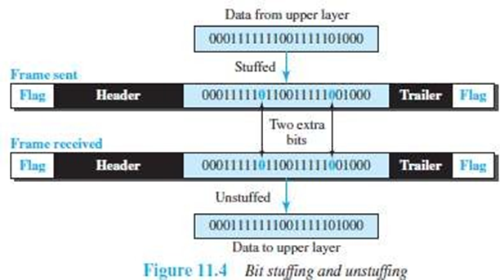
Bit Oriented Framing
In short, bit stuffing is the process of adding one extra 0 whenever five consecutive 1s follow a 0 in the data, so that the receiver does not mistake the pattern 0111110 for a flag.

Slide 53
Flow Control and Error Control
One of the responsibilities of the DLC sublayer is flow and error control at the data-link layer.
Flow Control
Whenever an entity produces items and another entity consumes them, there should be a balance between production and consumption rates.
If the items are produced faster than they can be consumed, the consumer can be overwhelmed and may need to discard some items.
We need to prevent losing the data items at the consumer site.
At the sending node, the data-link layer tries to push frames toward the data-link layer at the receiving node.
If the receiving node cannot process and deliver the packet to its network at the same rate that the frames arrive, it becomes overwhelmed with frames.
Here, flow control can be feedback from the receiving node to the sending node to stop or slow down pushing frames.

Slide 54
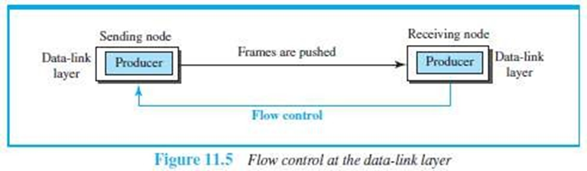
Flow Control and Error Control

Slide 55
Buffers
Flow control can be implemented by using buffer.
A buffer is a set of memory locations that can hold packets at the sender and receiver.
Normally, two buffers can be used.
First buffer at the sender.
Second buffer at the receiver.
The flow control communication can occur by sending signals from the consumer to the producer.
When the buffer of the receiver is full, it informs the sender to stop pushing frames.

Slide 56
Error Control
Error-control includes both error-detection and error-correction.
Error-control allows the receiver to inform the sender of any frames lost/damaged in transmission.
A CRC is
added to the frame header by the sender and
checked by the receiver.
At the data-link layer, error control is normally implemented using one of the following two methods.
If the frame is corrupted, it is discarded;
If the frame is not corrupted, the packet is delivered to the network layer.
This method is used mostly in wired LANs such as Ethernet.
If the frame is corrupted, it is discarded;
If the frame is not corrupted, an acknowledgment is sent to the sender.
Acknowledgment is used for the purpose of both flow and error control.

Slide 57
Connectionless and Connection-Oriented
A DLC protocol can be either connectionless or connection-oriented.
Connectionless Protocol
Frames are sent from one node to the next without any relationship between the frames; each frame is independent.
The term connectionless does not mean that there is no physical connection (transmission medium) between the nodes; it means that there is no connection between frames.
The frames are not numbered and there is no sense of ordering.
Most of the data-link protocols for LANs are connectionless protocols.

Slide 58
Connectionless and Connection-Oriented
Connection Oriented Protocol
A logical connection should first be established between the two nodes (setup phase).
After all frames that are somehow related to each other are transmitted (transfer phase), the logical connection is terminated (teardown phase).
The frames are numbered and sent in order.
If the frames are not received in order, the receiver needs to wait until all frames belonging to the same set are received and then deliver them in order to the network layer.
Connection oriented protocols are rare in wired LANs, but we can see them in some point-to- point protocols, some wireless LANs, and some WANs.

Slide 59
DATA LINK LAYER PROTOCOLS
Traditionally 2 protocols have been defined for the data-link layer to deal with flow and error control:
Simple Protocol
Stop-and-Wait Protocol.
The behavior of a data-link-layer protocol can be better shown as a finite state machine (FSM).
An FSM is a machine with a finite number of states.
The machine is always in one of the states until an event occurs.
Each event is associated with 2 reactions:
Defining the list (possibly empty) of actions to be performed.
Determining the next state (which can be the same as the current state).
One of the states must be defined as the initial state, the state in which the machine starts when it turns on.

Slide 60
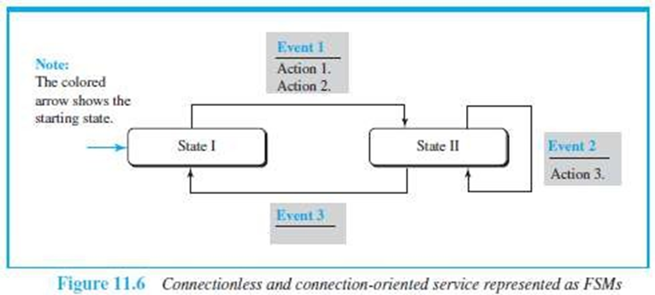
DATA LINK LAYER PROTOCOLS

Slide 61
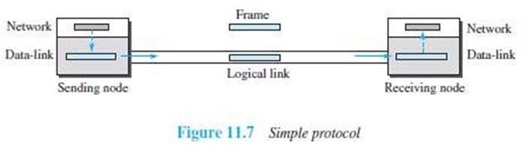
Simplest Protocol
Assumptions:
The protocol has neither flow-control nor error-control.
The protocol is a unidirectional protocol (in which frames are traveling in only one direction).
The receiver can immediately handle any frame it receives.

Slide 62
Design
How it works?
At Sender
The data-link-layer
gets data(packet) from its network-layer
makes a frame out of the data(packet)
sends the frame.
At Receiver
The data-link-layer
receives a frame from its physical layer
extracts data from the frame
delivers the data to its network-layer.
Data-link-layers of sender & receiver provide transmission services for their network-layers.
Data-link-layers use the services provided by their physical layers for the physical transmission of bits.

Slide 63
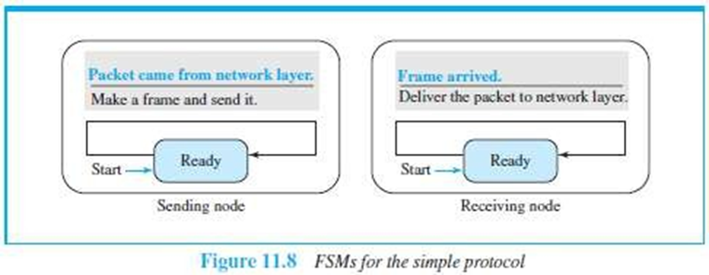
FSMs
Two main requirements:
The sender-site cannot send a frame until its network-layer has a data packet to send.
The receiver-site cannot deliver a data packet to its network-layer until a frame arrives.
These 2 requirements are shown using two FSMs.
Each FSM has only one state, the ready state.

Slide 64
How it works?
At Sending Machine
The sending machine remains in the ready state until a request comes from the process in the network layer.
When this event occurs, the sending machine encapsulates the message in a frame and sends it to the receiving machine.
At Receiving Machine
The receiving machine remains in the ready state until a frame arrives from the sending machine.
When this event occurs, the receiving machine decapsulates the message out of the frame and delivers it to the process at the network layer.

Slide 65
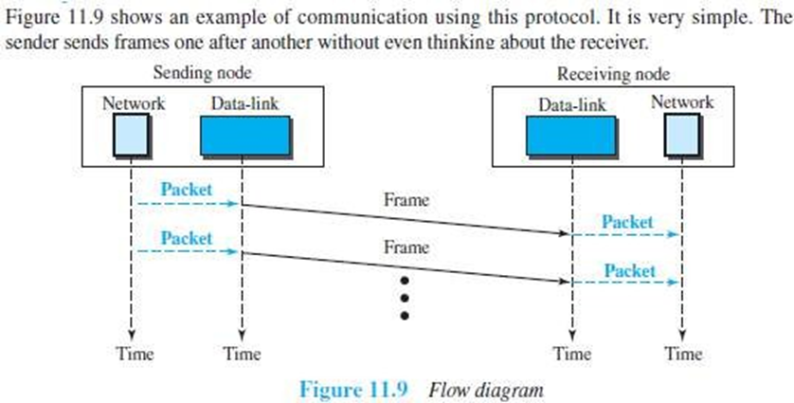
Example

Slide 66
Stop & Wait Protocol
This uses both flow and error control.
Normally, the receiver has limited storage-space.
If the receiver is receiving data from many sources, the receiver may
be overloaded with frames
discard the frames.
To prevent the receiver from being overloaded with frames, we need to tell the sender to slow down.

Slide 67
Design
At Sender
The sender
sends one frame & starts a timer
keeps a copy of the sent-frame
waits for ACK-frame from the receiver.
Then,
If an ACK-frame arrives before the timer expires, the timer is stopped and the sender sends the next frame.
Also, the sender discards the copy of the previous frame.
If the timer expires before ACK-frame arrives, the sender resends the previous frame and restarts the timer
At Receiver
To detect corrupted frames, a CRC is added to each data frame.
When a frame arrives at the receiver-site, the frame is checked.
If frame’s CRC is incorrect, the frame is corrupted and discarded.
The silence of the receiver is a signal for the sender that a frame was either corrupted or lost.

Slide 68
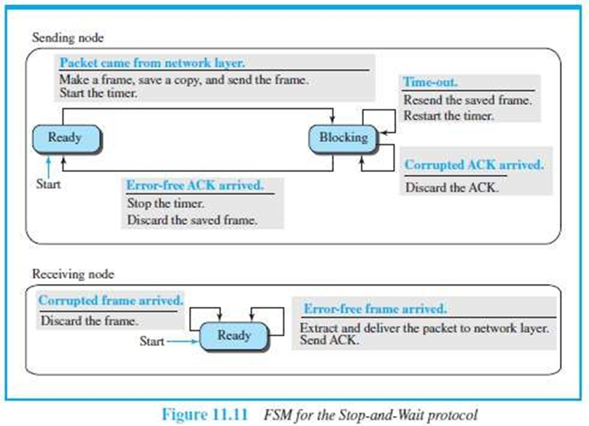
FSMs

Slide 69
How it works ?
Sender States
Sender is initially in the ready state, but it can move between the ready and blocking state.
Ready State: When the sender is in this state, it is only waiting for a packet from the network layer.
If a packet comes from the network layer, the sender creates a frame, saves a copy of the frame, starts the only timer and sends the frame. The sender then moves to the blocking state.
Blocking State: When the sender is in this state, three events can occur:
If a time-out occurs, the sender resends the saved copy of the frame and restarts the timer.
If a corrupted ACK arrives, it is discarded.
If an error-free ACK arrives, the sender stops the timer and discards the saved copy of the frame. It then moves to the ready state.

Slide 70
How it works ?
Receiver
The receiver is always in the ready state. Two events may occur:
If an error-free frame arrives, the message in the frame is delivered to the network layer and an ACK is sent.
If a corrupted frame arrives, the frame is discarded.

Slide 71
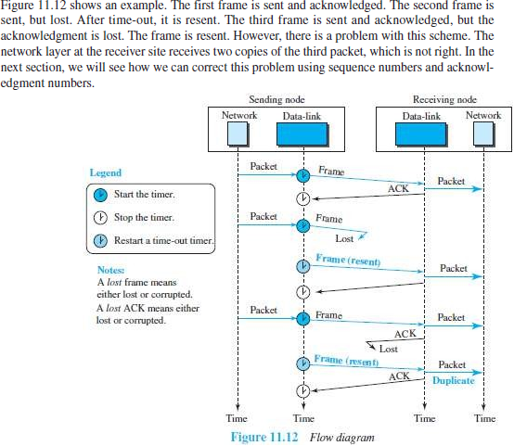
Example

